Slide 1
Storage and File Structure
Notes:
‹#›

Slide 2
Storage and File Structure
Overview of Physical Storage Media
Magnetic Disks
Disk Scheduling
Multiprocessing
RAID
File Organization
Buffer Management
Notes:
‹#›

Slide 3
Classification of Physical Storage Media
Speed with which data can be accessed
Cost per unit of data
Reliability
data loss on power failure or system crash
physical failure of the storage device
Can differentiate storage into:
volatile storage: loses contents when power is switched off
non-volatile storage:
Contents persist even when power is switched off.
Includes secondary and tertiary storage, as well as battery-backed up main-memory.
Notes:
‹#›

Slide 4
Physical Storage Media
Cache – fastest and most costly form of storage; volatile; managed by the computer system hardware.
Main memory:
fast access (10s to 100s of nanoseconds; 1 nanosecond = 10^{–9} seconds)
generally too small (or too expensive) to store the entire database
capacities of up to a few Gigabytes widely used currently
Capacities have gone up and per-byte costs have decreased steadily and rapidly (roughly factor of 2 every 2 to 3 years)
Volatile — contents of main memory are usually lost if a power failure or system crash occurs.
Notes:
‹#›

Slide 5
Physical Storage Media (Cont.)
Flash memory
Data survives power failure
Data can be written at a location only once, but location can be erased and written to again
Can support only a limited number (10K – 1M) of write/erase cycles.
Erasing of memory has to be done to an entire bank of memory
Reads are roughly as fast as main memory
But writes are slow (few microseconds), erase is slower
Widely used in embedded devices such as digital cameras, phones, and USB keys
Notes:
‹#›

Slide 6
Physical Storage Media (Cont.)
Magnetic-disk
Data is stored on spinning disk, and read/written magnetically
Primary medium for the long-term storage of data; typically stores entire database.
Data must be moved from disk to main memory for access, and written back for storage
Much slower access than main memory (more on this later)
direct-access – possible to read data on disk in any order, unlike magnetic tape
Capacities typically used are roughly several TB
Much larger capacity and cost/byte than main memory/flash memory
Growing constantly and rapidly with technology improvements (factor of 2 to 3 every 2 years)
Survives power failures and system crashes
disk failure can destroy data, but is rare
Notes:
‹#›

Slide 7
Physical Storage Media (Cont.)
Optical storage
non-volatile, data is read optically from a spinning disk using a laser
CD-ROM (640 MB) and DVD (4.7 to 17 GB) most popular forms
Blu-ray disks: 27 GB to 54 GB
Write-one, read-many (WORM) optical disks used for archival storage (CD-R, DVD-R, DVD+R)
Multiple write versions also available (CD-RW, DVD-RW, DVD+RW, and DVD-RAM)
Reads and writes are slower than with magnetic disk
Juke-box systems, with large numbers of removable disks, a few drives, and a mechanism for automatic loading/unloading of disks available for storing large volumes of data
Notes:
‹#›

Slide 8
Physical Storage Media (Cont.)
Optical storage
An optical jukebox is a robotic data storage device that can automatically load and unload optical discs, such as Compact Disc, DVD, Ultra Density Optical or Blu-ray disc and can provide terabytes (TB) and petabytes (PB) of tertiary storage.
The devices are often called optical disk libraries, robotic drives, or autochangers. Jukebox devices may have up to 2,000 slots for disks, and usually have a picking device that traverses the slots and drives.
The arrangement of the slots and picking devices affects performance, depending on the space between a disk and the picking device.
Seek times and transfer rates vary depending upon the optical technology.
Notes:
‹#›

Slide 9
Physical Storage Media (Cont.)
Tape storage
non-volatile, used primarily for backup (to recover from disk failure), and for archival data
sequential-access – much slower than disk
very high capacity (40 to 300 GB tapes available)
tape can be removed from drive ⇒ storage costs much cheaper than disk, but drives are expensive
Tape jukeboxes available for storing massive amounts of data
hundreds of terabytes (1 terabyte = 10⁹ bytes) to even multiple petabytes (1 petabyte = 10¹² bytes)
Notes:
‹#›

Slide 10
Magnetic Tapes
Hold large volumes of data and provide high transfer rates
Few GB for DAT (Digital Audio Tape) format, 10-40 GB with DLT (Digital Linear Tape) format, 100 GB+ with Ultrium format, and 330 GB with Ampex helical scan format
Transfer rates from few to 10s of MB/s
Tapes are cheap, but cost of drives is very high
Very slow access time in comparison to magnetic and optical disks
limited to sequential access.
Some formats (Accelis) provide faster seek (10s of seconds) at cost of lower capacity
Used mainly for backup, for storage of infrequently used information, and as an off-line medium for transferring information from one system to another.
Tape jukeboxes used for very large capacity storage
Multiple petabyes (10¹⁵ bytes)
Notes:
‹#›

Slide 11
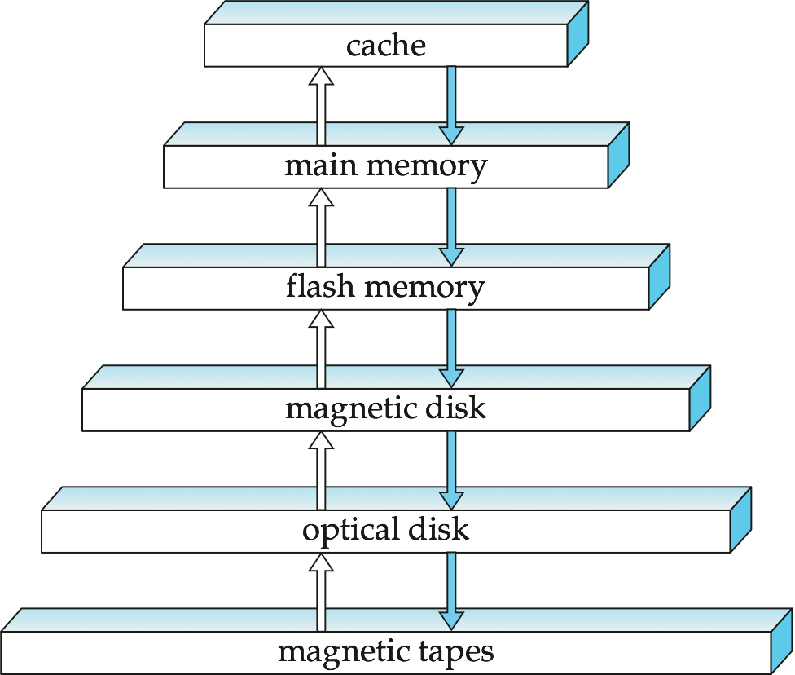
Storage Hierarchy
Notes:
‹#›

Slide 12
Storage Hierarchy (Cont.)
primary storage: Fastest media but volatile (cache, main memory).
secondary storage: next level in hierarchy, non-volatile, moderately fast access time
also called on-line storage
E.g. flash memory, magnetic disks
tertiary storage: lowest level in hierarchy, non-volatile, slow access time
also called off-line storage
E.g. magnetic tape, optical storage
Notes:
‹#›

Slide 13
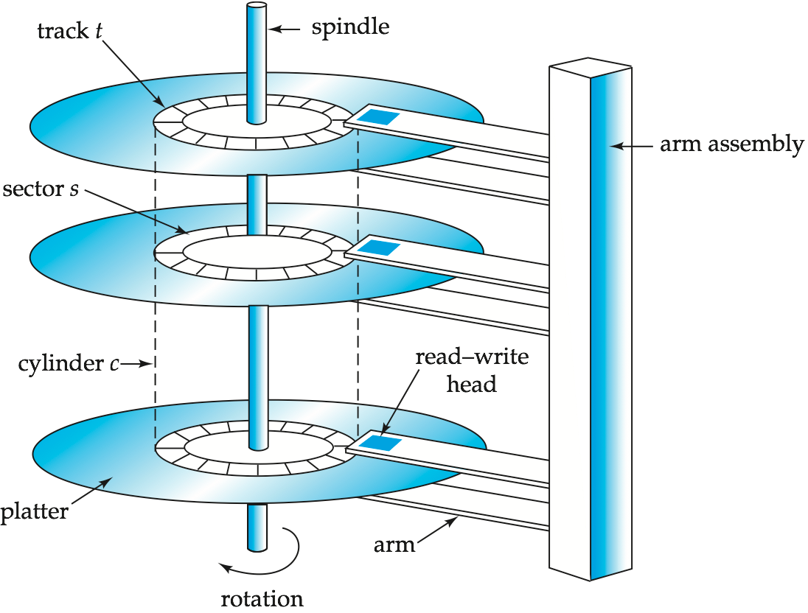
Magnetic Hard Disk Mechanism
NOTE: Diagram is schematic, and simplifies the structure of actual disk drives
Notes:
‹#›

Slide 14
Magnetic Disks
Read-write head
Positioned very close to the platter surface (almost touching it)
Reads or writes magnetically encoded information.
Surface of platter divided into circular tracks
Over 50K-100K tracks per platter on typical hard disks
Each track is divided into sectors.
A sector is the smallest unit of data that can be read or written.
Sector size typically 512 bytes
Typical sectors per track: 500 to 1000 (on inner tracks) to 1000 to 2000 (on outer tracks)
To read/write a sector
disk arm swings to position head on right track
platter spins continually; data is read/written as sector passes under head
Head-disk assemblies
multiple disk platters on a single spindle (1 to 5 usually)
one head per platter, mounted on a common arm.
Cylinder i consists of i^{th} track of all the platters
Notes:
‹#›

Slide 15
Performance Measures of Disks
Access time – the time it takes from when a read or write request is issued to when data transfer begins. Consists of:
Seek time – time it takes to reposition the arm over the correct track.
Average seek time is 1/2 the worst case seek time.
we ignore the time to start and stop arm movement
4 to 10 milliseconds on typical disks
Rotational latency – time it takes for the sector to be accessed to appear under the head.
Average latency is 1/2 of the worst case latency.
4 to 11 milliseconds on typical disks (5400 to 15000 r.p.m.)
Data-transfer rate – the rate at which data can be retrieved from or stored to the disk.
25 to 100 MB per second max rate, lower for inner tracks
Multiple disks may share a controller, so rate that controller can handle is also important
E.g. SATA: 150 MB/sec, SATA-II 3Gb (300 MB/sec)
Ultra 320 SCSI: 320 MB/s, SAS (3 to 6 Gb/sec)
Fiber Channel (FC2Gb or 4Gb): 256 to 512 MB/s
Notes:
‹#›

Slide 16
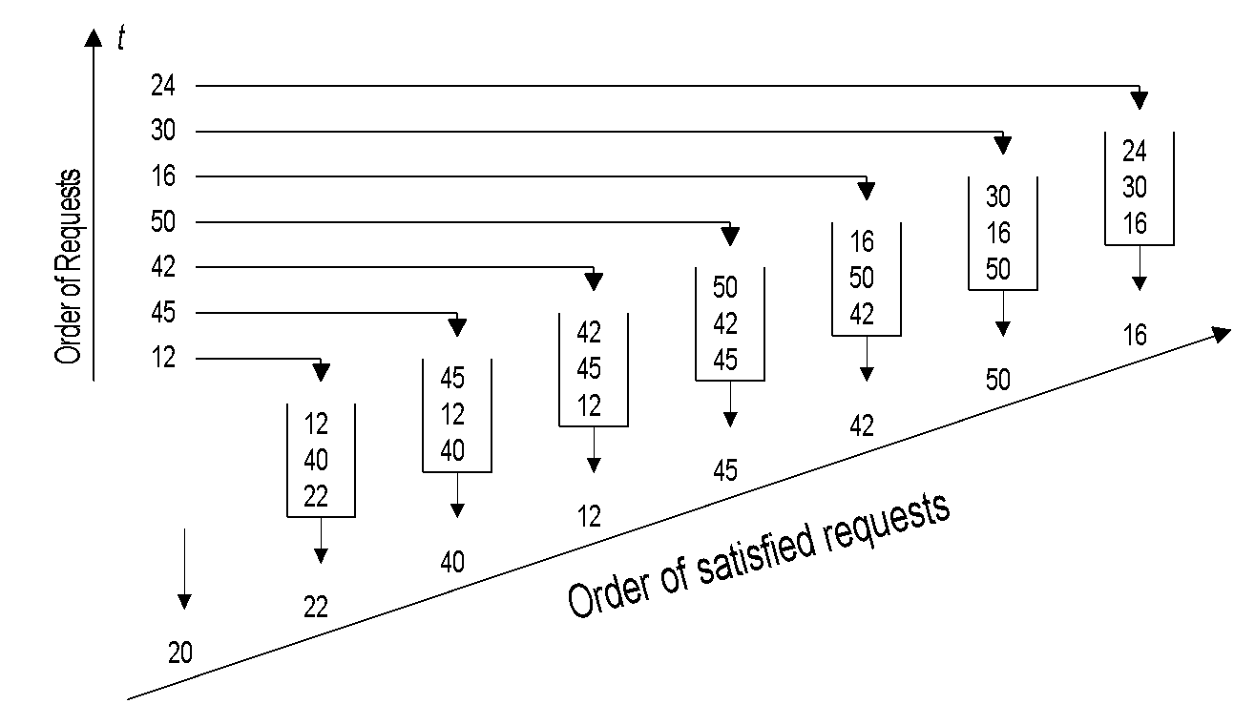
Disk Scheduling: FCFS
Advantages:
Intrinsically fair
Simple
Disadvantages:
Not optimal with respect to head movement.
high average seek time.
‹#›

Slide 17
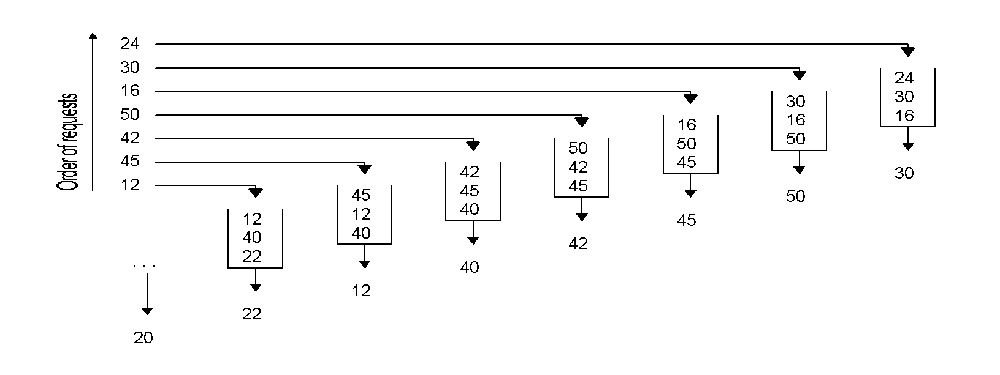
Disk Scheduling: Shortest-Seek-Time First (SSTF)
SSTF selects among all requests the one with the minimum seek time from the current head position.
Advantage: optimal in terms of seek time.
Disadvantage: request targets in the middle of the disk are preferred over those in the innermost and outermost disk areas. Starvation can occur.
‹#›

Slide 18
Disk Scheduling: SCAN
24
30
24
16
30
16
Order of requests
50
16
16
12
42
50
50
12
45
42
45
12
24
12
45
45
12
30
12
12
12
50
Head moves
40
40
45
downwards
. . .
22
42
40
22
Head moves upwards
20
Like SSTF, SCAN orders requests to minimize seek time.
In contrast to SSTF, SCAN takes the direction of the current disk movement into account.
It first serves all requests in one direction until it does not have any request in this direction anymore.
The head movement is then reversed and service is continued.
Note: Middle tracks still get a better service then edge tracks.
‹#›

Slide 19
Disk Scheduling: C-SCAN
C-SCAN only retrieves data in one direction to ensure fairness.
One idle head movement from one edge to the other between two consecutive scans.
Performance of C-SCAN is somewhat less than SCAN.
24
30
24
16
30
30
Order of requests
50
16
16
16
42
50
50
12
45
42
45
12
16
12
45
45
12
12
12
12
12
50
Head moves
40
40
45
upwards
. . .
22
42
40
22
Head moves upwards
20
‹#›

Slide 20
Optimization of Disk Block Access (Cont.)
File organization – optimize block access time by organizing the blocks to correspond to how data will be accessed
E.g. Store related information on the same or nearby cylinders.
Files may get fragmented over time
E.g. if data is inserted to/deleted from the file
Or free blocks on disk are scattered, and newly created file has its blocks scattered over the disk
Sequential access to a fragmented file results in increased disk arm movement
Some systems have utilities to defragment the file system, in order to speed up file access
Notes:
‹#›

Slide 21
Improvement of Reliability via Redundancy
Redundancy – store extra information that can be used to rebuild information lost in a disk failure
E.g., Mirroring (or shadowing)
Duplicate every disk. Logical disk consists of two physical disks.
Every write is carried out on both disks
Reads can take place from either disk
If one disk in a pair fails, data still available in the other
Data loss would occur only if a disk fails, and its mirror disk also fails before the system is repaired
Probability of combined event is very small
Except for dependent failure modes such as fire or building collapse or electrical power surges
Notes:
‹#›

Slide 22
Performance Measures
Mean time to failure (MTTF) – the average time the disk is expected to run continuously without any failure.
Typically 3 to 5 years (approx. 30,000 to 50,000 hours)
Probability of failure of new disks is quite low, corresponding to a “theoretical MTTF” of 500,000 to 1,200,000 hours for a new disk
E.g., an MTTF of 1,200,000 hours for a new disk means that given 1000 relatively new disks, on an average one will fail every 1200 hours
MTTF decreases as disk ages
Notes:
‹#›

Slide 23
Mean time to data loss
Mean time to data loss depends on mean time to failure, and mean time to repair
E.g. MTTF of 100,000 hours, mean time to repair of 10 hours gives mean time to data loss of 500*10⁶ hours (or 57,000 years) for a mirrored pair of disks.

Slide 24
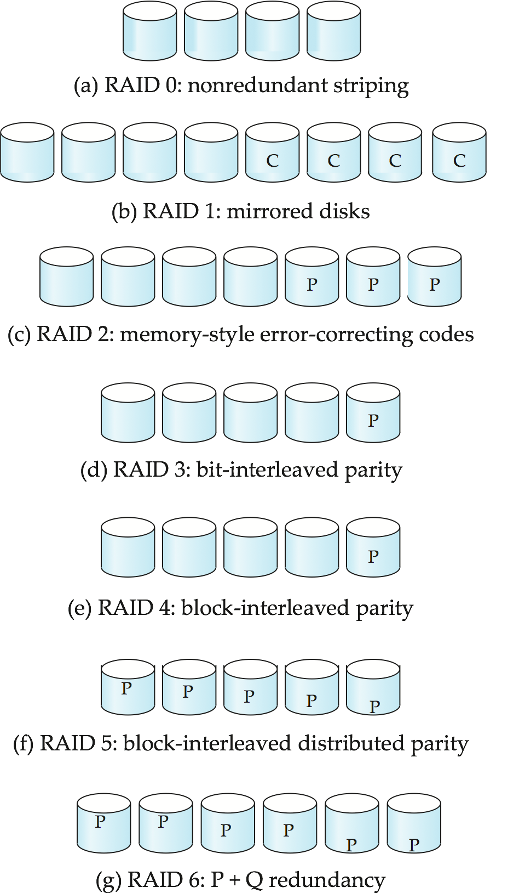
Figure 10.03
Notes:
‹#›

Slide 25
Choice of RAID Level
Factors in choosing RAID level
Monetary cost
Performance: Number of I/O operations per second, and bandwidth during normal operation
Performance during failure
Performance during rebuild of failed disk
Including time taken to rebuild failed disk
RAID 0 is used only when data safety is not important
E.g. data can be recovered quickly from other sources
Level 2 and 4 never used since they are subsumed by 3 and 5
Level 3 is not used anymore since bit-striping forces single block reads to access all disks, wasting disk arm movement, which block striping (level 5) avoids
Level 6 is rarely used since levels 1 and 5 offer adequate safety for most applications
Notes:
‹#›

Slide 26
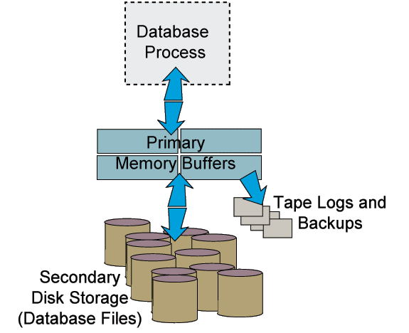
Big Picture
From Keith Van Rhein’s slide,
LOYOLA UNIVERSITY CHICAGO

Slide 27
File Organization
The database is stored as a collection of files. Each file is a sequence of records. A record is a sequence of fields.
Organization of Records in files
Two different types of Records
Notes:
‹#›

Slide 28
Organization of Records in Files
Heap – a record can be placed anywhere in the file where there is space
Hashing – a hash function computed on some attribute of each record; the result specifies in which bucket (a set of blocks) of the file the record should be placed
Sequential – store records in sequential order, based on the value of the search key of each record
Records of each relation may be stored in a separate file. In a multitable clustering file organization records of several different relations can be stored in the same file
Motivation: store related records on the same block to minimize I/O
Notes:
‹#›

Slide 29
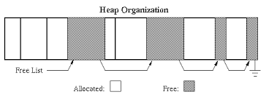
Organization of Records in Files
Heap – a record can be placed anywhere in the file where there is space
Notes:
‹#›

Slide 30
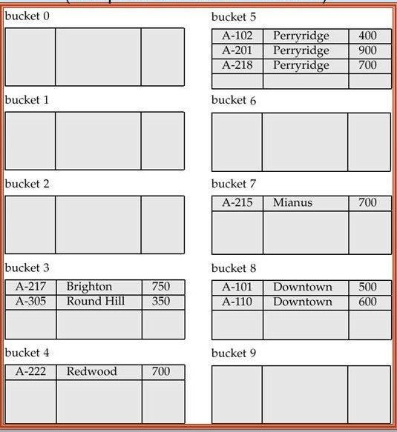
Organization of Records in Files
Hashing – a hash function computed on some attribute of each record; the result specifies in which bucket (a set of blocks) of the file the record should be placed
Notes:
‹#›

Slide 31
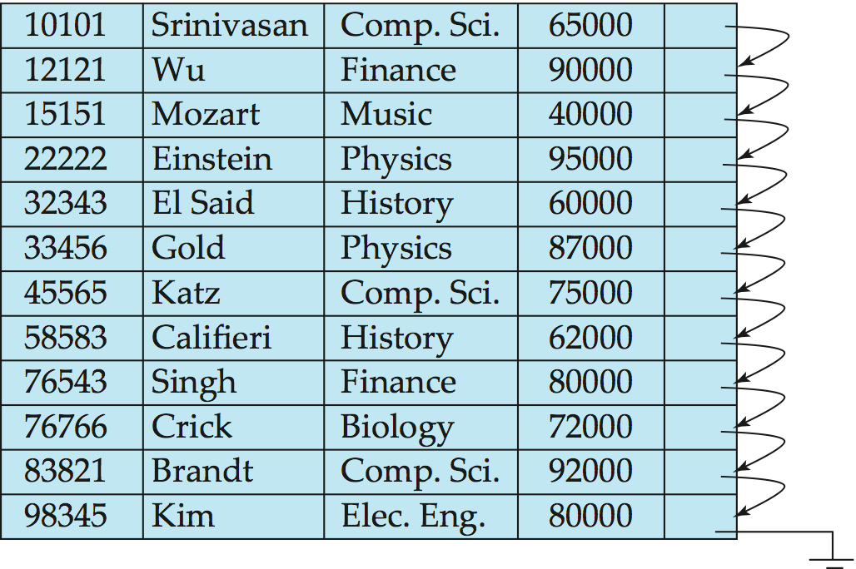
Organization of Records in Files
Sequential – store records in sequential order, based on the value of the search key of each record
Suitable for applications that require sequential processing of the entire file
Notes:
‹#›

Slide 32
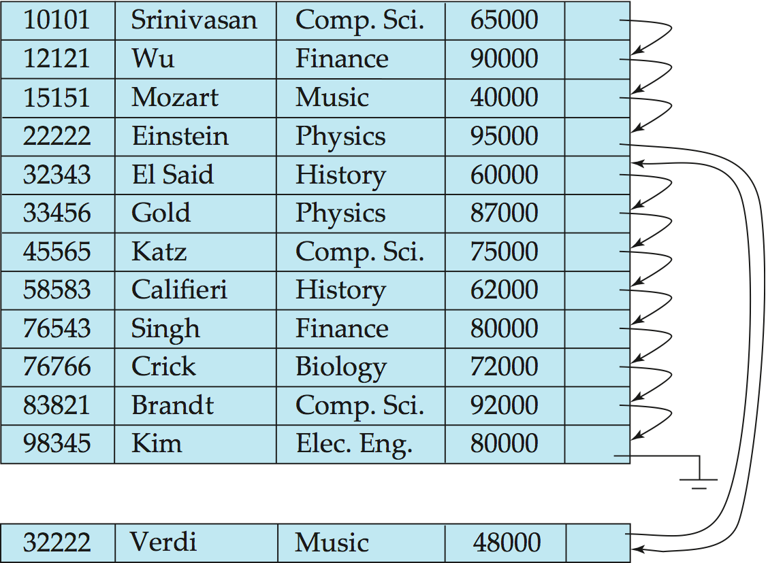
Sequential File Organization (Cont.)
Deletion – use pointer chains
Insertion –locate the position where the record is to be inserted
if there is free space insert there
if no free space, insert the record in an overflow block
In either case, pointer chain must be updated
Need to reorganize the file from time to time to restore sequential order
Notes:
‹#›

Slide 33
Organization of Records in Files
Records of each relation may be stored in a separate file. In a multitable clustering file organization records of several different relations can be stored in the same file
Motivation: store related records on the same block to minimize I/O
Notes:
‹#›

Slide 34
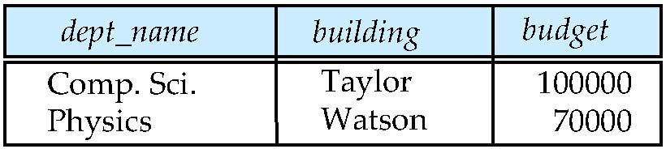
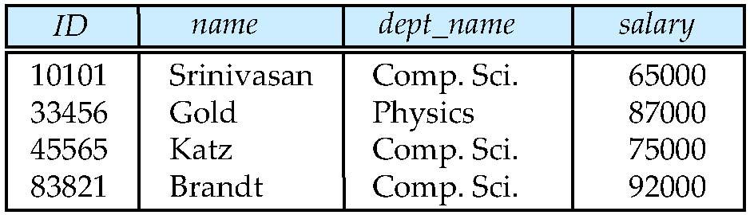
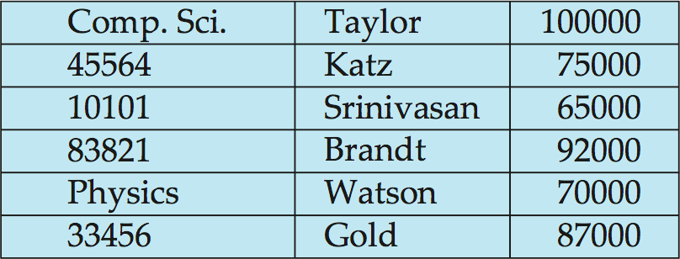
Multi table Clustering File Organization
Store several relations in one file using a multitable clustering file organization
department
instructor
multitable clustering
of department and
instructor
Notes:
‹#›

Slide 35
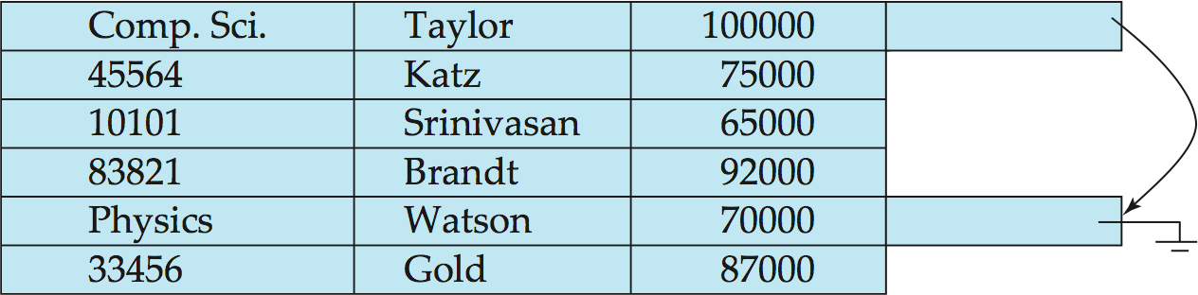
Multitable Clustering File Organization (cont.)
good for queries involving department instructor, and for queries involving one single department and its instructors
bad for queries involving only department
results in variable size records
Can add pointer chains to link records of a particular relation

Slide 36
Two different types of Records
Fixed-Length Records:
assume record size is fixed
each file has records of one particular type only
different files are used for different relations
This case is easiest to implement; will consider variable length records later.
Simple approach:
Store record i starting from byte n*(i ), where n is the size of each record.
Record access is simple but records may cross blocks
Modification: do not allow records to cross block boundaries
Notes:
‹#›

Slide 37
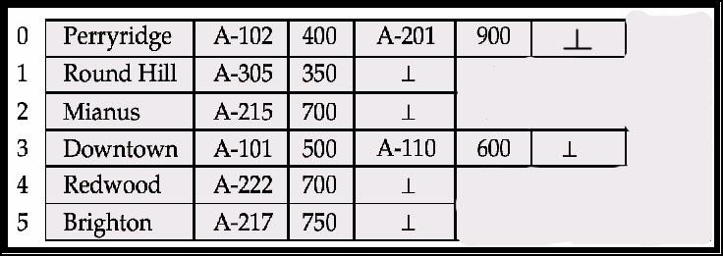
Variable-Length Records
Variable-length records arise in database systems in several ways:
Storage of multiple record types in a file.
Record types that allow variable lengths for one or more fields such as strings (varchar)
Notes:
‹#›

Slide 38
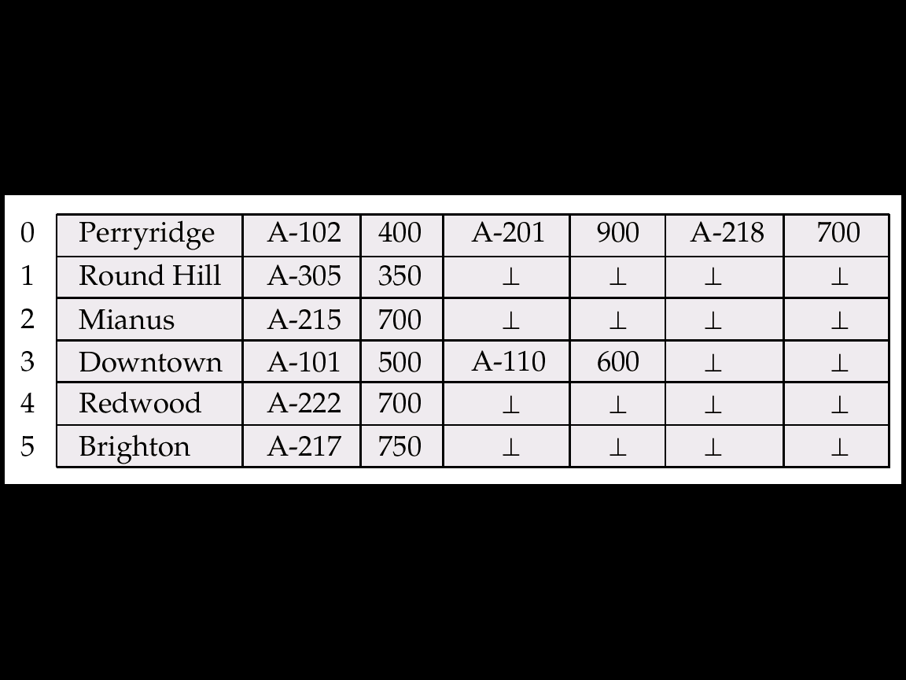
Variable-Length Records - Fixed-length Representation

Slide 39
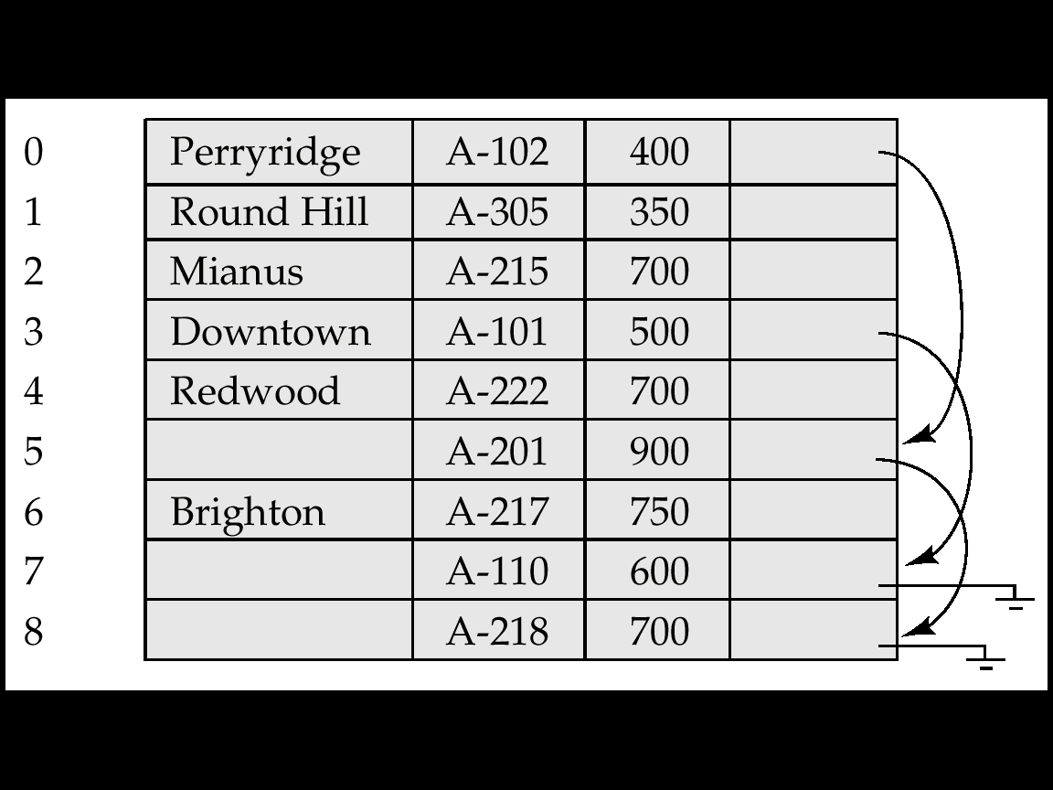
Pointer Method
Pointer method
A variable-length record is represented by a list of fixed-length records, chained together via pointers.
Can be used even if the maximum record length is not known

Slide 40
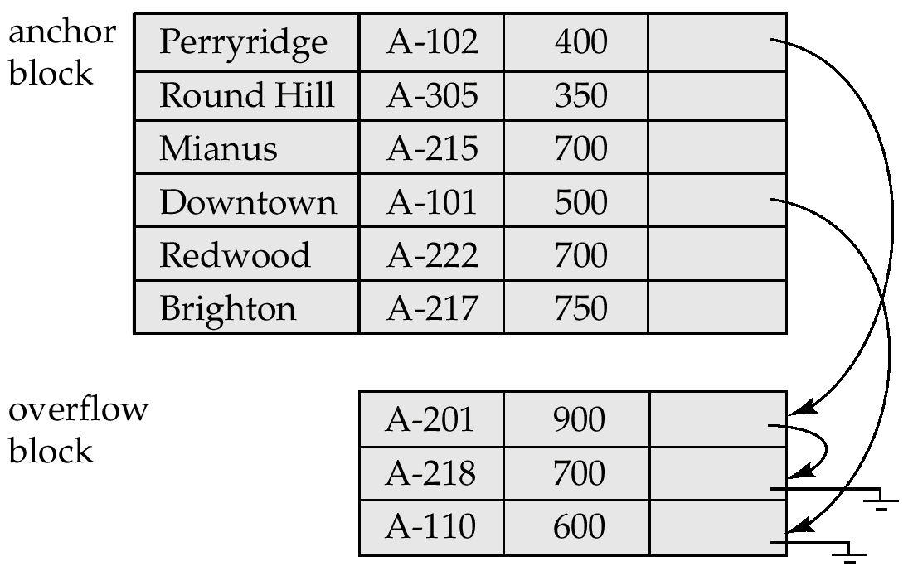
Pointer Method (Cont.)
Waste space
Solution is to allow two kinds of block in file:
Anchor block – contains the first records of chain
Overflow block – contains records other than those that are the first records of chains.

Slide 41
Storage Access
A database file is partitioned into fixed-length storage units called blocks. Blocks are units of both storage allocation and data transfer.
Database system seeks to minimize the number of block transfers between the disk and memory. We can reduce the number of disk accesses by keeping as many blocks as possible in main memory.
Buffer – portion of main memory available to store copies of disk blocks.
Buffer manager – subsystem responsible for allocating buffer space in main memory.
Notes:
‹#›

Slide 42
Buffer Manager
Programs call on the buffer manager when they need a block from disk.
If the block is already in the buffer, buffer manager returns the address of the block in main memory
If the block is not in the buffer, the buffer manager
Allocates space in the buffer for the block
Replacing (throwing out) some other block, if required, to make space for the new block.
Replaced block written back to disk only if it was modified since the most recent time that it was written to/fetched from the disk.
Reads the block from the disk to the buffer, and returns the address of the block in main memory to requester.
Notes:
‹#›

Slide 43
Buffer-Replacement Policies
Least recently used (LRU strategy) – Most operating systems use this
Idea behind LRU – use past pattern of block references as a predictor of future references
LRU can be a bad strategy for certain access patterns involving repeated scans of data
For example: when computing the join of 2 relations r and s by a nested loops
for each tuple tr of r do for each tuple ts of s do if the tuples tr and ts match …
Pinned block is better
Queries have well-defined access patterns (such as sequential scans), and a database system can use the information in a user’s query to predict future references
Mixed strategy with hints on replacement strategy provided by the query optimizer is preferable
Notes:
‹#›

Slide 44
Buffer-Replacement Policies (Cont.)
Pinned block – system pins a memory block that is not allowed to be written back to disk.
Toss-immediate – frees the space occupied by a block as soon as the final tuple of that block has been processed
Most recently used (MRU) – system replaces most recently used block
Buffer manager can use statistical information regarding the probability that a request will reference a particular relation
E.g., the data dictionary is frequently accessed. Heuristic: keep data-dictionary blocks in main memory buffer
Notes:
‹#›

Slide 45
End of Chapter 10
Notes:
‹#›

